Slide 1
Introducing Bounded Rationality to Lakeland
Huayi Lin, Enver Miguel, and Claire McIlvennie

Slide 2
Reminder: Model formulation
- Fish population: Standard logistic growth
- Gold mine: non-renewable resource
- Agents have mining and fishing skills
- Agents derive income from mining and
selling surplus fish
Utility of agents: Income and Leisure
(subsistence and leisure needs).

Slide 3
Four cognitive processing styles
Uncertainty
tolerance
Aspiration level
high
satisfaction
low
repetition
deliberate (optimize)
low
uncertainty
social comparison (inquire)
imitation
high

Slide 4
Project 2: Expanding the Model
What if agents are not all interact but spatially distributed and interact in a social network?
What if there are different degrees of conformity? (including additional needs: identity/understanding).
What if information and knowledge is not perfect (model of fish stock, limited observations of returns of actions of others)?

Slide 5
Project 2: Expanding the Model
What if agents are not all interact but spatially distributed and interact in a social network?
What if there are different degrees of conformity? (including additional needs: identity/understanding).
What if information and knowledge is not perfect (model of fish stock, limited observations of returns of actions of others)?

Slide 6
Modification 1: Spatial
Before
After: Spatially Distributed Agents
Fishing & Mining

Slide 7
Modification 1: Spatial
What percentage of the world does a turtle learn from?
Spatially Distributed Agents
Fishing & Mining

Slide 8
Modification 1: Spatial
What percentage of the world does a turtle learn from?
How fast do turtles move around the world?
Spatially Distributed Agents
Fishing & Mining

Slide 9
Modification 1: Spatial
What percentage of the world does a turtle learn from?
How fast do turtles move around the world?
Turtles move towards similar others re: fishing and mining
Spatially Distributed Agents
Fishing & Mining

Slide 10
Modification 2: Variability in Utility Function
Before: Vary but same for all turtles
Fishing & Mining

Slide 11
Modification 2: Variability in Utility Function
Before: Vary but same for all turtles
After: Introduced a switch for variability
Fishing & Mining

Slide 12
Modification 3: Memory of Agents
[maybe add]

Slide 13
Analyses
Experiment 1: Neighborhoods with Movement
Experiment 2: Neighborhoods with Flocking
Experiment 3: Variability in Utility Preferences (Gamma)

Slide 14
Experiment 1: Neighborhood Size + Speed

Slide 15
Experiment 1b: Neighborhood Size + Speed

Slide 16
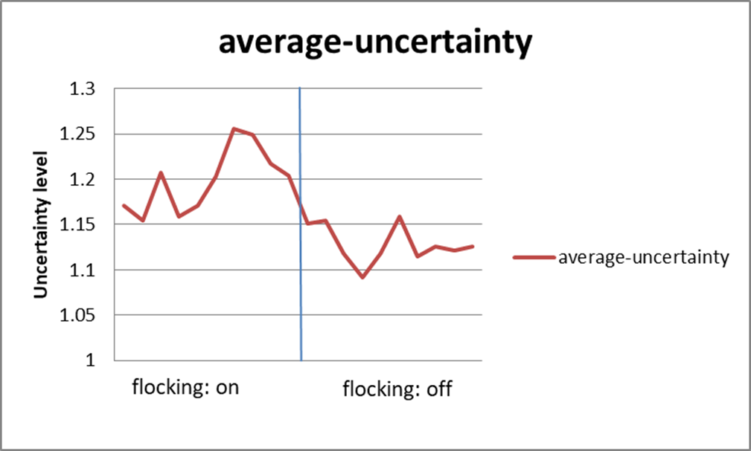
Experiment 2: Neighborhood + Flocking

Slide 17
Experiment 3: Varying Utility Preferences ( )

Slide 18
Experiment 3: Varying Utility Preferences ( )

Slide 19
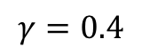
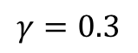
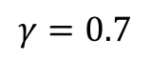
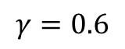
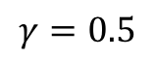
$$γ=0.3$$
$$γ=0.4$$
$$γ=0.5$$
$$γ=0.6$$
$$γ=0.7$$

Slide 20
Conclusions and Future Modifications

